Slide 1
Type Rating Skill Test Examiner Briefing
Not for operationel use

Slide 2
Briefing Card SKT privileges
Not for operationel use
Formålet med ”Briefing Card SKT privileges” er at guide Senior Examiner igennem de briefing-elementer, der skal dækkes i forbindelse med en assessment, der giver en examiner SKT rettigheder.
PART-FCL har ikke defineret nogen træningskrav for at give SKT rettighed til en examiner, derfor vil denne procedure dække netop de forskelle der er mellem en examiner med PC rettigheder og en examiner med SKT rettigheder.
Efter denne briefing og en bestået assessment, vil examiner have rettigheden til at lave type rating skilltest. Her skal det klarificeres for applikanten at det ikke inkluderer MPL, og ATPL skilltest, ej heller instructor assessments.
Følgende forskelle er identificeret mellem PC rettigheden og SKT rettigheden og skal briefes inden afholdelse af assessment.

Slide 3
Emner til gennnemgang:
Not for operationel use
Formularer, inklusive mandatory items og underskrifter
Uddannelseskrav PART-FCL inklusive:
Course completion certificate
Skilltest på ikke-EASA certifikatindehavere
Skilltest for at overføre ikke EASA typerettigheder til EASA certifikat
Krav til IR(A)ME, hvad hvis den er udløbet
Brug af ”Temp permit to act as pilot” inclusive procedure og ansvar
”Examiner differences document” samt rapporteringskrav på examiner.dk
Krav om feedback til ATO
Vested interests inklusive:
CFI og HT begrænsninger
Examiners deltagelse i pilotens træning
Indhold af briefing og teoretisk overhøring

Slide 4
PROCEDURE FOR DESIGNATING EXAMINERS TO CONDUCT SKILLTESTS
Not for operationel use
ARA.FCL.205 Monitoring of examiners require that the authority developes procedures to designate examiners to conduct skilltests. The Danish Transport Authority have made the following requirements if an examiner seeks this privilege: - have a valid examiner certificate - be considered competent for the task - have an acceptable personality and character - show good cooperation with the competent authority. - meet requirements in Commission Regulation (EU) No 1178/2011 subpart K - attend an examiner seminar - have conducted 20 relevant checks as examiner or have recieved additional Examiner training covering these privileges - perform an examiner assessment of competence during a skilltest - meet any other requirements considered relevant The authorities can require documentation and a meeting to make sure that above mentioned requirements are fulfilled.

Slide 5
PROCEDURE FOR DESIGNATING EXAMINERS TO CONDUCT SKILLTESTS
Not for operationel use
Holders of an examiner certificate shall:
(1) hold an equivalent licence, rating or certificate to the ones for which they are authorised to conduct skill tests, proficiency checks or assessments of competence and the privilege to instruct for them;
(2) be qualified to act as PIC on the aircraft during a skill test, proficiency check or assessment of competence when conducted on the aircraft.
Prerequisites for examiners:
Applicants for an examiner certificate shall demonstrate:
(a) relevant knowledge, background and appropriate experience related to the privileges of an examiner;
(b) that they have not been subject to any sanctions, including the suspension, limitation or revocation of any of their licences, ratings or certificates issued in accordance with this Part, for non-compliance with the Basic Regulation and its Implementing Rules during the last 3 years.
When evaluating the applicant’s background, the competent authority should evaluate the personality and character of the applicant, and his/her cooperation with the competent authority. The competent authority may also take into account whether the applicant has been convicted of any relevant criminal or other offenses, taking into account national law and principles of nondiscrimination.

Slide 6
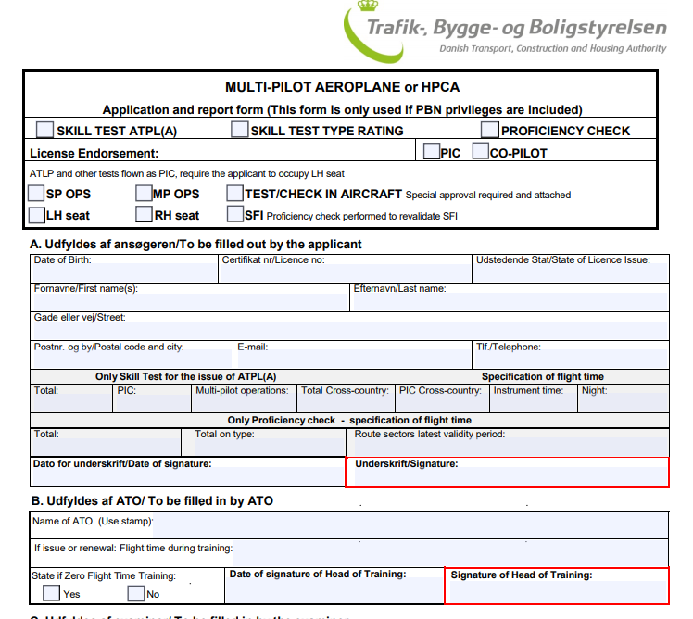
Formularer, inklusive mandatory items og underskrifter
Not for operationel use
Open

Slide 7
Formularer, inklusive mandatory items og underskrifter
Not for operationel use
Multi-pilot aeroplanes and single-pilot high performance complex aeroplanes:
The following symbols mean:
P = Trained as PIC or Co-pilot and as PF and PNF for the issue of a type rating as applicable.
X = Simulators shall be used for this exercise, if available; otherwise an aircraft shall be used if appropriate for the manoeuvre or procedure.
P# = The training shall be complemented by supervised aeroplane inspection.
(b) The practical training shall be conducted at least at the training equipment level shown as (P), or may be conducted up to any higher equipment level shown by the arrow (—–>).
The following abbreviations are used to indicate the training equipment used:
A = Aeroplane
FFS = Full Flight Simulator
FTD = Flight Training Device
OTD = Other Training Devices

Slide 8
Formularer, inklusive mandatory items og underskrifter
Not for operationel use
(c) The starred items (*) shall be flown solely by reference to instruments. If this condition is not met during the skill test or proficiency check, the type rating will be restricted to VFR only.
(d) Where the letter ‘M’ appears in the skill test or proficiency check column this will indicate the mandatory exercise.
(e) An FFS shall be used for practical training and testing if the FFS forms part of an approved type rating course. The following considerations will apply to the approval of the course:
(i) the qualification of the FFS or FNPT II;
FNPT II: A ground based training device which represents the flight deck environment of a multi- engine aeroplane type or class to the extent that the systems appear to function as in an aeroplane.
(ii) the qualifications of the instructors;
(iii) the amount of FFS or FNPT II training provided on the course; and
(iv) the qualifications and previous experience on similar types of the pilot under training.
(f) Manoeuvres and procedures shall include MCC for multi-pilot aeroplane and for single-pilot high performance complex aeroplanes in multi-pilot operations.
Danish form:M+ marked skill test only, EASA: (skill test only)

Slide 9
Formularer, inklusive mandatory items og underskrifter
Not for operationel use
Mandatory items:
Use of checklist.
Before takeoff checks.
Takeoff with engine failure between V1 and V2.
Rejected takeoff.
Adherence to departure route and ATC instructions.
3D approach manually without FD.
3D approach with one engine inoperative.
2D approach down to MDA/H
Manual go-around with one engine inoperative after an instrument approach on reaching MDA/H or MAPt.
Landing one engine inoperative.

Slide 10
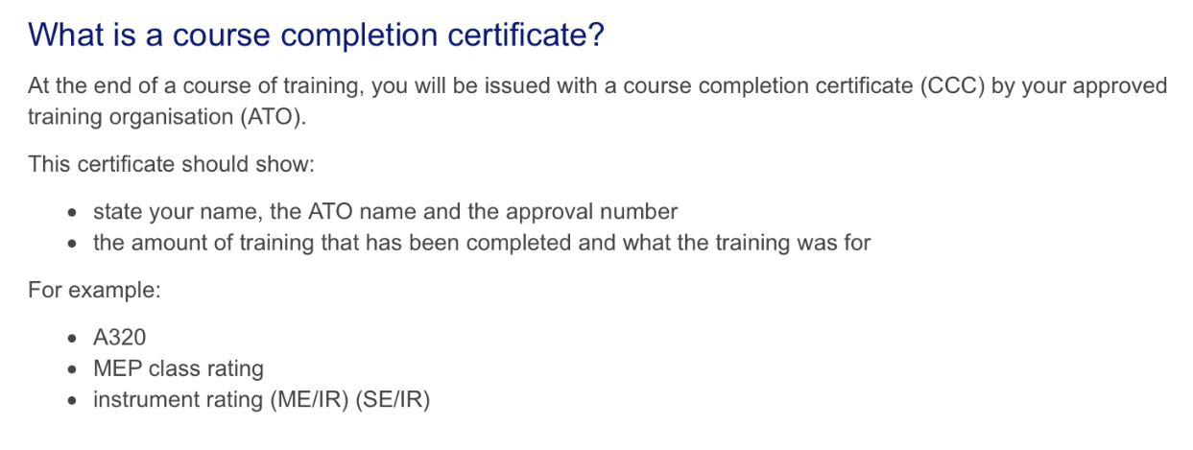
Uddannelseskrav PART-FCL :
Not for operationel use
Course completion certificate

Slide 11
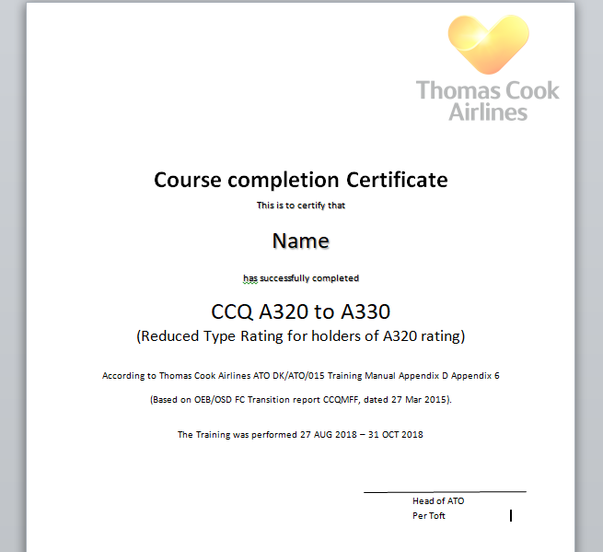
Uddannelseskrav PART-FCL :
Not for operationel use
Course completion certificate

Slide 12
Uddannelseskrav PART-FCL :
Not for operationel use
Skilltest på ikke-EASA certifikatindehavere:
Skilltest på ikke EASA piloter beskrives ingen steder og kan derfor kun udføres efter tilladelse fra pilotens myndighed. Her skal examiner være meget påpasselig med, at den prøve der laves ikke overskrider de rettigheder der er givet fra fremmed myndighed, samt de begrænsninger der måtte være på EASA examiner certifikat.

Slide 13
Uddannelseskrav PART-FCL :
Not for operationel use
Skilltest for at overføre ikke EASA typerettigheder til EASA certifikat:
PART-FCL Annex III C:
ACCEPTANCE OF CLASS AND TYPE RATINGS
1. A valid class or type rating contained in a licence issued by a third country may be inserted in a Part-FCL licence provided that the applicant:
(a) complies with the experience requirements and the prerequisites for the issue of the applicable type or class rating in accordance with Part-FCL;
(b) passes the relevant skill test for the issue of the applicable type or class rating in accordance with Part-FCL;
(c) is in current flying practice;
(d) has no less than:
(i) for aeroplane class ratings, 100 hours of flight experience as a pilot in that class;
(ii) for aeroplane type ratings, 500 hours of flight experience as a pilot in that type;
(iii) for single-engine helicopters with a maximum certificated take-off mass of up to 3 175 kg, 100 hours of flight experience as a pilot in that type;
(iv) for all other helicopters, 350 hours of flight experience as a pilot on that type.

Slide 14
Uddannelseskrav PART-FCL :
Not for operationel use
Krav om gyldig Multi Engine IR (MEIR) ved type rating:
Ved første type rating skal man have en gyldig MEIR, ingen udtagelser.
Ved yderligere type ratings, accepterer vi at aspiranten ikke har gyldig MEIR ved kursets start. Men så skal der lægges ekstra træning ind i uddannelsen, som kompenserer for dette.

Slide 15
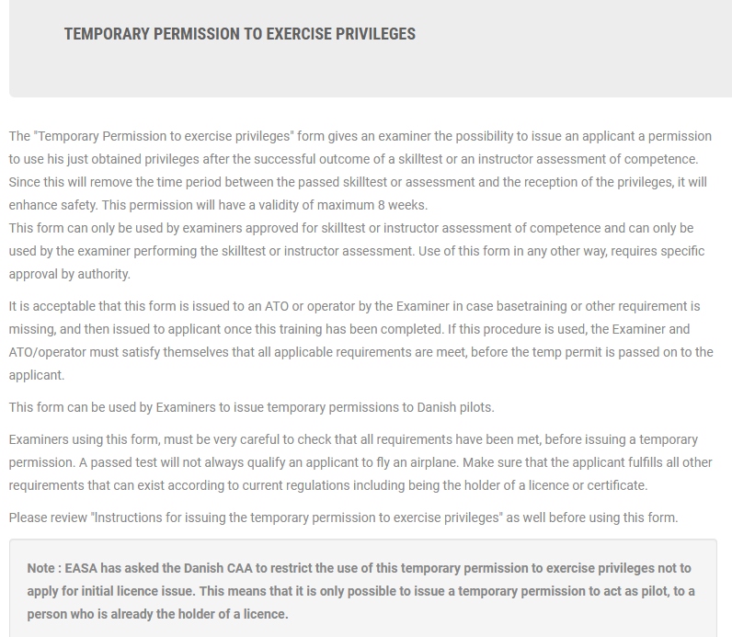
Brug af ”Temp permit to act as pilot” inclusive procedure og ansvar
Not for operationel use

Slide 16
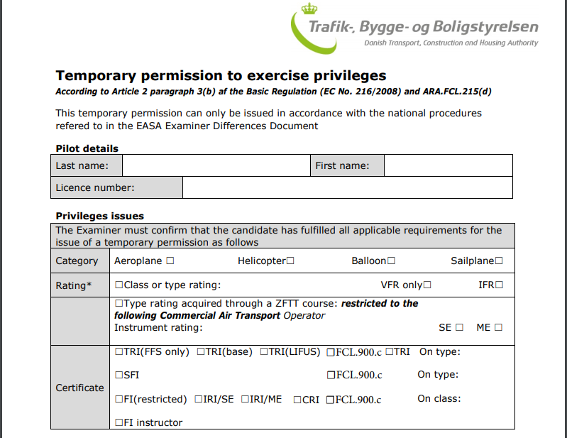
Brug af ”Temp permit to act as pilot” inclusive procedure og ansvar
Not for operationel use
Open

Slide 17
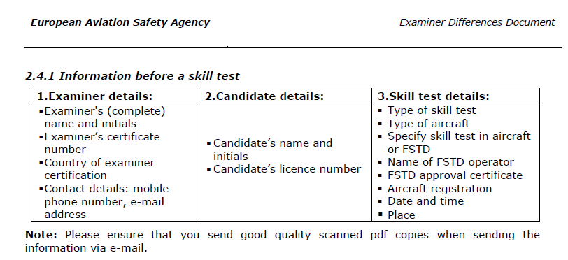
”Examiner differences document” samt rapporteringskrav på examiner.dk
Not for operationel use
Dokumentet Open

Slide 18
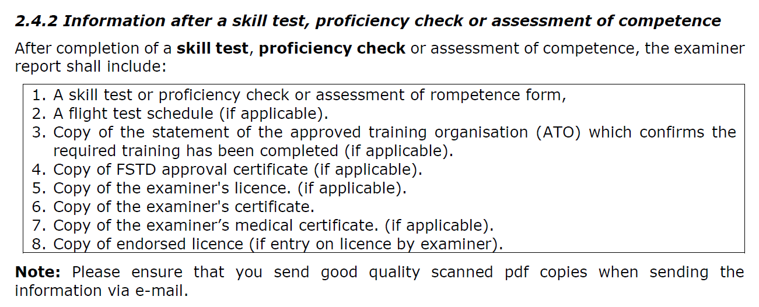
”Examiner differences document” samt rapporteringskrav på examiner.dk
Not for operationel use

Slide 19
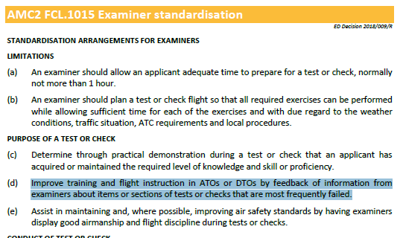
Krav om feedback til ATO
Not for operationel use

Slide 20
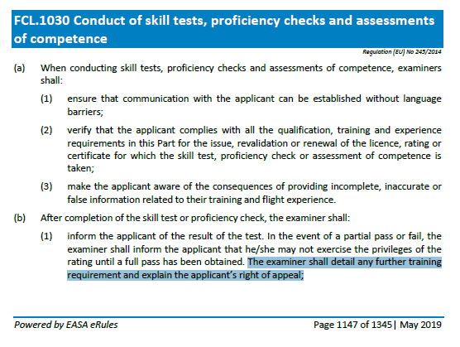
Krav om feedback til ATO
Not for operationel use

Slide 21
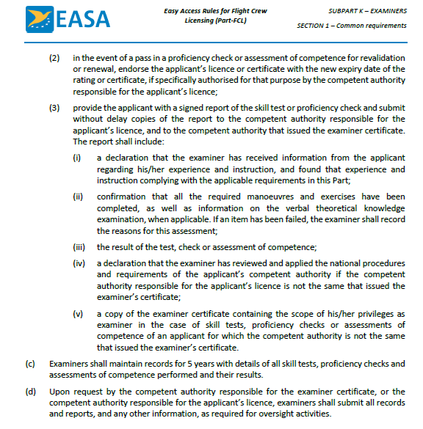
Mere FCL.1030 Conduct of skill tests, proficiency checks and assessments of competence.
Not for operationel use

Slide 22
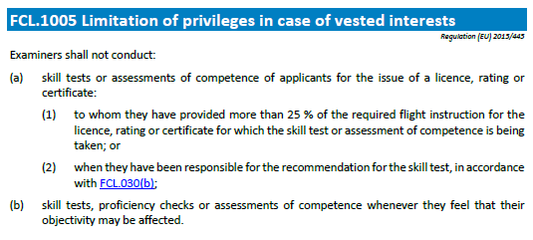
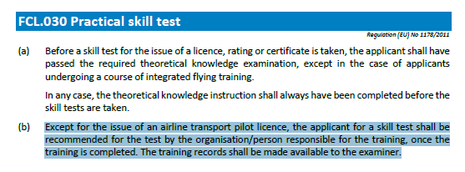
Vested interests
Not for operationel use
CFI og HT må ikke teste

Slide 23
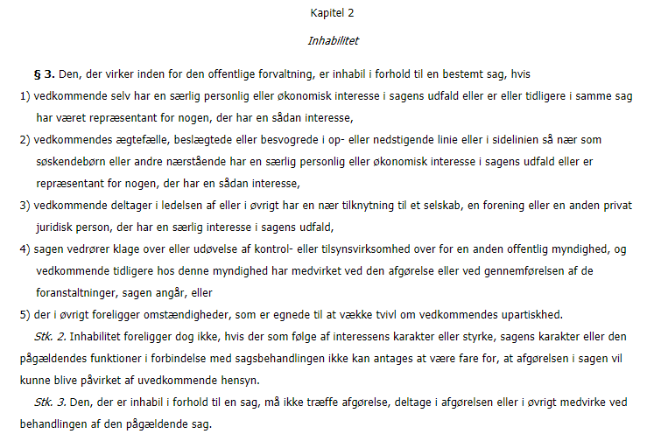
Vested interests / forvaltningsloven i Danmark
Not for operationel use

Slide 24
Examiner standardisation
Not for operationel use
AMC2 FCL.1015 Examiner standardisation
STANDARDISATION ARRANGEMENTS FOR EXAMINERS
LIMITATIONS
(a) An examiner should allow an applicant adequate time to prepare for a test or check, normally not more than 1 hour.
(b) An examiner should plan a test or check flight so that all required exercises can be performed while allowing sufficient time for each of the exercises and with due regard to the weather conditions, traffic situation, ATC requirements and local procedures.
PURPOSE OF A TEST OR CHECK
(c) Determine through practical demonstration during a test or check that an applicant has acquired or maintained the required level of knowledge and skill or proficiency.
(d) Improve training and flight instruction in ATOs or DTOs by feedback of information from examiners about items or sections of tests or checks that are most frequently failed.
(e) Assist in maintaining and, where possible, improving air safety standards by having examiners display good airmanship and flight discipline during tests or checks.

Slide 25
Examiner standardisation
Not for operationel use
STANDARDISATION ARRANGEMENTS FOR EXAMINERS
CONDUCT OF TEST OR CHECK
(f) An examiner will ensure that an applicant completes a test or check in accordance with Part-FCL requirements and is assessed against the required test or check standards.
(g) Each item within a test or check section should be completed and assessed separately. The test or check schedule, as briefed, should not normally be altered by an examiner. A failed item is not always a failed section, for example type rating skill test where a failure of an item in a section does not fail the entire section, only the failed item is taken again.
(h) Marginal or questionable performance of a test or check item should not influence an examiner’s assessment of any subsequent items.
(i) An examiner should verify the requirements and limitations of a test or check with an applicant during the pre-flight briefing.
(j) When a test or check is completed or discontinued, an examiner should debrief the applicant and give reasons for items or sections failed. In case of a failed or discontinued skill test and proficiency check, the examiner should provide appropriate advice to assist the applicant in re-tests or re-checks.
(k) Any comment on, or disagreement with, an examiner’s test or check evaluation or assessment made during a debriefing will be recorded by the examiner on the test or check report, and will be signed by the examiner and countersigned by the applicant.

Slide 26
Not for operationel use
Examiner standardisation
STANDARDISATION ARRANGEMENTS FOR EXAMINERS
EXAMINER PREPARATION
An examiner should supervise all aspects of the test or check flight preparation, including, where necessary, obtaining or assuring an ATC ‘slot’ time.
(l) An examiner will plan a test or check in accordance with Part-FCL requirements. Only the manoeuvres and procedures set out in the appropriate test or check form will be undertaken. The same examiner should not reexamine a failed applicant without the agreement of the applicant.
EXAMINER APPROACH
(m) An examiner should encourage a friendly and relaxed atmosphere to develop both before and during a test or check flight. A negative or hostile approach should not be used. During the test or check flight, the examiner should avoid negative comments or criticisms and all assessments should be reserved for the debriefing.

Slide 27
Not for operationel use
Examiner standardisation
STANDARDISATION ARRANGEMENTS FOR EXAMINERS
ASSESSMENT SYSTEM
(n) Although test or checks may specify flight test tolerances, an applicant should not be expected to achieve these at the expense of smoothness or stable flight. An examiner should make due allowance for unavoidable deviations due to turbulence, ATC instructions, etc. An examiner should terminate a test or check only when it is clear that the applicant has not been able to demonstrate the required level of knowledge, skill or proficiency and that a full re-test will be necessary or for safety reasons. An examiner will use one of the following terms for assessment:
(1)a ‘pass’, provided that the applicant demonstrates the required level of knowledge, skill or proficiency and, where applicable, remains within the flight test tolerances for the licence or rating;
(2)a ‘fail’ provided that any of the following apply:
(i) the flight test tolerances have been exceeded after the examiner has made due allowance for turbulence or ATC instructions;
(ii) the aim of the test or check is not completed;
(iii) the aim of exercise is completed but at the expense of safe flight, violation of a rule or regulation, poor airmanship or rough handling;
(iv) an acceptable level of knowledge is not demonstrated;
(v) an acceptable level of flight management is not demonstrated;
(vi)the intervention of the examiner or safety pilot is required in the interest of safety.
(3)a ‘partial pass’ in accordance with the criteria shown in the relevant skill test
appendix of Part-FCL.

Slide 28
Examiner standardisation
Not for operationel use
STANDARDISATION ARRANGEMENTS FOR EXAMINERS
METHOD AND CONTENTS OF THE TEST OR CHECK
(o) Before undertaking a test or check an examiner will verify that the aircraft or FSTD intended to be used is suitable and appropriately equipped for the test or check.
(p) A test or check flight will be conducted in accordance with the AFM and, if applicable, the AOM.
(q) A test or check flight will be conducted within the limitations contained in the operations manual of an ATO or the operator for which the applicant is flying, as applicable, or, if available, within the limitations placed by the DTO.
(r) Contents:
(1) a test or check is comprised of:
(i) oral examination on the ground (where applicable);
(ii) pre-flight briefing;
(iii) in-flight exercises;
(iv) post-flight debriefing.

Slide 29
Indhold af briefing og teoretisk overhøring
Not for operationel use
STANDARDISATION ARRANGEMENTS FOR EXAMINERS
METHOD AND CONTENTS OF THE TEST OR CHECK
(2) oral examination on the ground should include:
(i) aircraft general knowledge and performance;
(ii) planning and operational procedures;
(iii)ther relevant items or sections of the test or check.
(3) pre-flight briefing should include:
(i) test or check sequence;
(ii) power setting, speeds and approach minima, if applicable;
(iii) safety considerations.
(4) in-flight exercises will include each relevant item or section of the test or check;
(5) post-flight debriefing should include:
(i) assessment or evaluation of the applicant;
(ii) documentation of the test or check with the applicant’s FI present, if possible.

Slide 30
Indhold af briefing og teoretisk overhøring
Not for operationel use
STANDARDISATION ARRANGEMENTS FOR EXAMINERS
METHOD AND CONTENTS OF THE TEST OR CHECK
(s) A test or check is intended to simulate a practical flight. Thus, an examiner may set practical scenarios for an applicant while ensuring that the applicant is not confused and air safety is not compromised.
(t) When manoeuvres are to be flown by sole reference to instruments, the examiner should ensure that a suitable method of screening is used to simulate IMC.
(u) An examiner should maintain a flight log and assessment record during the test or check for reference during the post or flight debriefing.
(v) An examiner should be flexible to the possibility of changes arising to preflight briefings due to ATC instructions, or other circumstances affecting the test or check.
(w) Where changes arise to a planned test or check an examiner should be satisfied that the applicant understands and accepts the changes. Otherwise, the test or check flight should be terminated.
(x) Should an applicant choose not to continue a test or check for reasons considered inadequate by an examiner, the applicant will be assessed as having failed those items or sections not attempted. If the test or check is terminated for reasons considered adequate by the examiner, only these items or sections not completed will be tested during a subsequent test or check.
(y) An examiner may terminate a test or check at any stage, if it is considered that the applicant’s competency requires a complete re-test or re-check.

Slide 31
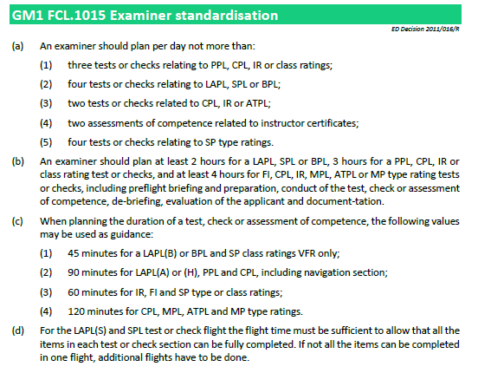
GM1 FCL.1015 Examiner standardisation
Not for operationel use

Slide 32
Appendix 9, Examiner standardisation
Not for operationel use
FLIGHT TEST TOLERANCE
Applicants shall demonstrate the ability to:
(a) operate the aeroplane within its limitations;
(b) complete all manoeuvres with smoothness and accuracy;
(c) exercise good judgement and airmanship;
(d) apply aeronautical knowledge;
(e) maintain control of the aeroplane at all times in such a manner that the successful outcome of a procedure or manoeuvre is never in doubt;
understand and apply crew coordination and incapacitation procedures, if applicable; and
communicate effectively with the other crew members, if applicable.

Slide 33
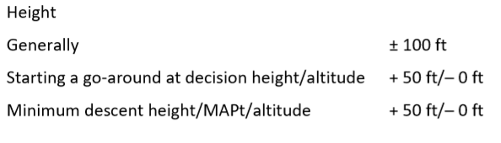
Appendix 9, Examiner standardisation
Not for operationel use
FLIGHT TEST TOLERANCE
The following limits shall apply, corrected to make allowance for turbulent conditions and the handling qualities and performance of the aeroplane used:

Slide 34
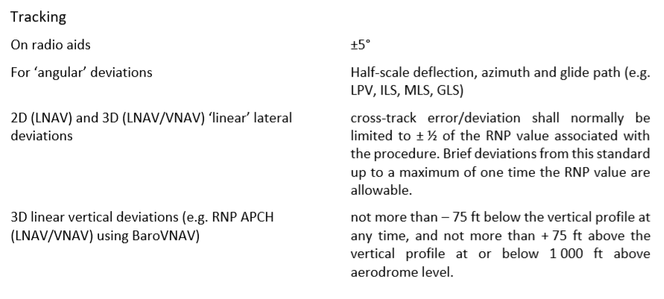
Appendix 9, Examiner standardisation
Not for operationel use
FLIGHT TEST TOLERANCE
The following limits shall apply, corrected to make allowance for turbulent conditions and the handling qualities and performance of the aeroplane used:

Slide 35
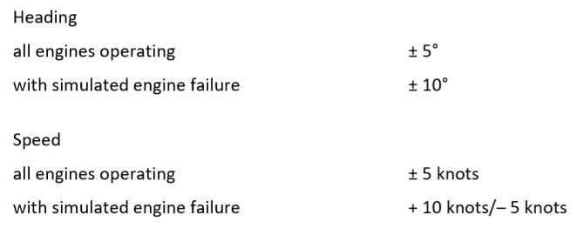
Appendix 9, Examiner standardisation
Not for operationel use
FLIGHT TEST TOLERANCE
The following limits shall apply, corrected to make allowance for turbulent conditions and the handling qualities and performance of the aeroplane used:

Slide 36
Appendix 9, Examiner standardisation
Not for operationel use
CONDUCT OF THE TEST/CHECK
Applicants shall be required to fly the aircraft from a position where the PIC or co-pilot functions, as relevant, can be performed. Under single-pilot conditions, the test shall be performed as if there was no other crew member present.
During preflight preparation for the test, applicants are required to determine power settings and speeds. Applicants shall indicate to the examiner the checks and duties carried out, including the identification of radio facilities. Checks shall be completed in accordance with the checklist for the aircraft on which the test is being taken and, if applicable, with the MCC concept. Performance data for take-off, approach and landing shall be calculated by applicants in compliance with the operations manual or flight manual for the aircraft used. Decision heights/altitudes, minimum descent heights/altitudes and missed approach point shall be agreed upon with the examiner.
The examiner shall take no part in the operation of the aircraft except where intervention is necessary in the interests of safety or to avoid unacceptable delay to other traffic.

Slide 37
Appendix 9, Examiner standardisation
Not for operationel use
SPECIFIC REQUIREMENTS FOR THE SKILL TEST/PROFICIENCY CHECK FOR MULTI-PILOT AIRCRAFT TYPE RATINGS, FOR SINGLE-PILOT AEROPLANE TYPE RATINGS WHEN OPERATED IN MULTI-PILOT OPERATIONS, FOR MPL AND ATPL:
The skill test for a multi-pilot aircraft or a single-pilot aeroplane when operated in multi-pilot operations shall be performed in a multi-crew environment. Another applicant or another type rated qualified pilot may function as the second pilot. If an aircraft is used, the second pilot shall be the examiner or an instructor.
Applicants shall operate as PF during all sections of the skill test, except for abnormal and emergency procedures, which may be conducted as PF or PM in accordance with MCC. Applicants for the initial issue of a multi-pilot aircraft type rating or ATPL shall also demonstrate the ability to act as PM. Applicants may choose either the left-hand or the right-hand seat for the skill test if all items can be executed from the selected seat.
The following matters shall be specifically checked by the examiner for applicants for the ATPL or a type rating for multi-pilot aircraft or for multi-pilot operations in a single-pilot aeroplane extending to the duties of a PIC, irrespective of whether the applicants act as PF or PM:
(a) managing crew cooperation;
(b) maintaining a general survey of the aircraft operation by appropriate supervision; and
setting priorities and making decisions in accordance with safety aspects and relevant rules and regulations appropriate to the operational situation, including emergencies.
The test or check should be accomplished under IFR, if the IR rating is included, and as far as possible be accomplished in a simulated commercial air transport environment. An essential element to be checked is the ability to plan and conduct the flight from routine briefing material.

Slide 38
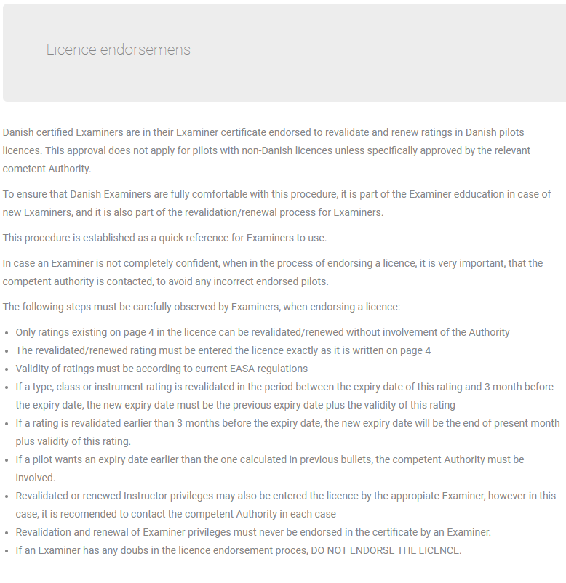
Licence endorsmens
Not for operationel use

Slide 39
Questions?

